Slide 1
Databricks meets Power BI
Gerhard Brueckl
Marcel Franke

Slide 2





Short Introduction - Marcel
https://github.com/marcelfranke
https://www.linkedin.com/in/marcelfranke/
marcel.franke@microsoft.com

Slide 3








Short Introduction - Gerhard
@gbrueckl
www.pmone.com
blog.gbrueckl.at
gerhard@gbrueckl.at
https://github.com/gbrueckl

Slide 4
Agenda
Why this session?
What do we want to test?
Our test environment
Loading data into Databricks
Data modelling in Databricks
Interaction between Databricks & Power BI
Summary

Slide 5
Why this session?
Big Data processing is becoming more and more important
Spark is the standard for Big Data processing
Databricks IS Spark
After processing – results have to be visualized
Power BI is THE reporting tool in the Microsoft world

Slide 6
Overview Databricks

Slide 7
What is Databricks?
Company that focuses on Big Data processing in the Cloud
Founded in 2013
Goal: Alternative to MapReduce
Creators of Apache® Spark™
Offers: Databricks on AWS, Azure Databricks

Slide 8

What is Apache Spark?
Project of the Apache Foundation
Largest open-source data project
Open-source Cluster computing framework
Runs on YARN, Mesos, …
Built for: Speed, Ease-of-Use, Extensibility
Support for multiple languages
Java, Scala, Python, R, SQL
Notes:
Spark is a general-purpose data processing engine that is suitable for use in a wide range of circumstances. Application developers and data scientists incorporate Spark into their applications to rapidly query, analyze, and transform data at scale. Tasks most frequently associated with Spark include interactive queries across large data sets, processing of streaming data from sensors or financial systems, and machine learning tasks.
Spark became an incubated project of the Apache Software Foundation in 2013, and it was promoted early in 2014 to become one of the Foundation’s top-level projects. Spark is currently one of the most active projects managed by the Foundation, and the community that has grown up around the project includes both prolific individual contributors and well-funded corporate backers such as Databricks, Microsoft, and China’s Huawei.
From the beginning, Spark was optimized to run in memory. It helps process data far more quickly than alternative approaches like Hadoop’s MapReduce, which tends to write data to and from computer hard drives between each stage of processing. Spark’s proponents claim that Spark’s running in memory can be 100 times faster than Hadoop MapReduce, and also 10 times faster when processing disk-based data in a way similar to Hadoop MapReduce itself. This comparison is not entirely fair, not least because raw speed tends to be more important to Spark’s typical use cases than it is to batch processing, at which MapReduce-like solutions still excel.

Slide 9

Why Spark?
Open-source data processing engine built around speed, ease of use, and sophisticated analytics
In memory engine that is up to 100 times faster than Hadoop
Largest open-source data project with 1000+ contributors
Highly extensible with support for Scala, Java and Python alongside Spark SQL, GraphX, Streaming and Machine Learning Library (Mllib)

Slide 10
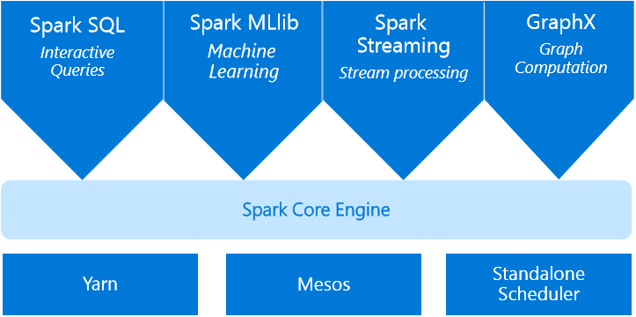
What is Apache Spark?
Spark Unifies:
Batch Processing
Interactive SQL
Real-time processing
Machine Learning
Deep Learning
Graph Processing

Slide 11
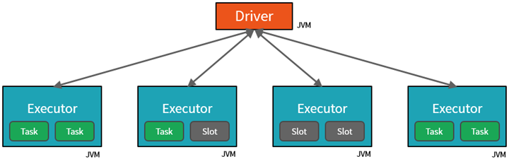
How does it work?
Notes:
Spark is designed to run on a cluster where the workload as spread across all the nodes. Basically, there is one driver (=head-node) and an arbitrary number of executors (=worker-nodes) where the driver controls all the executors. The executors are further separated into different slots where a slot can have a running task or is waiting for a new task.

Slide 12
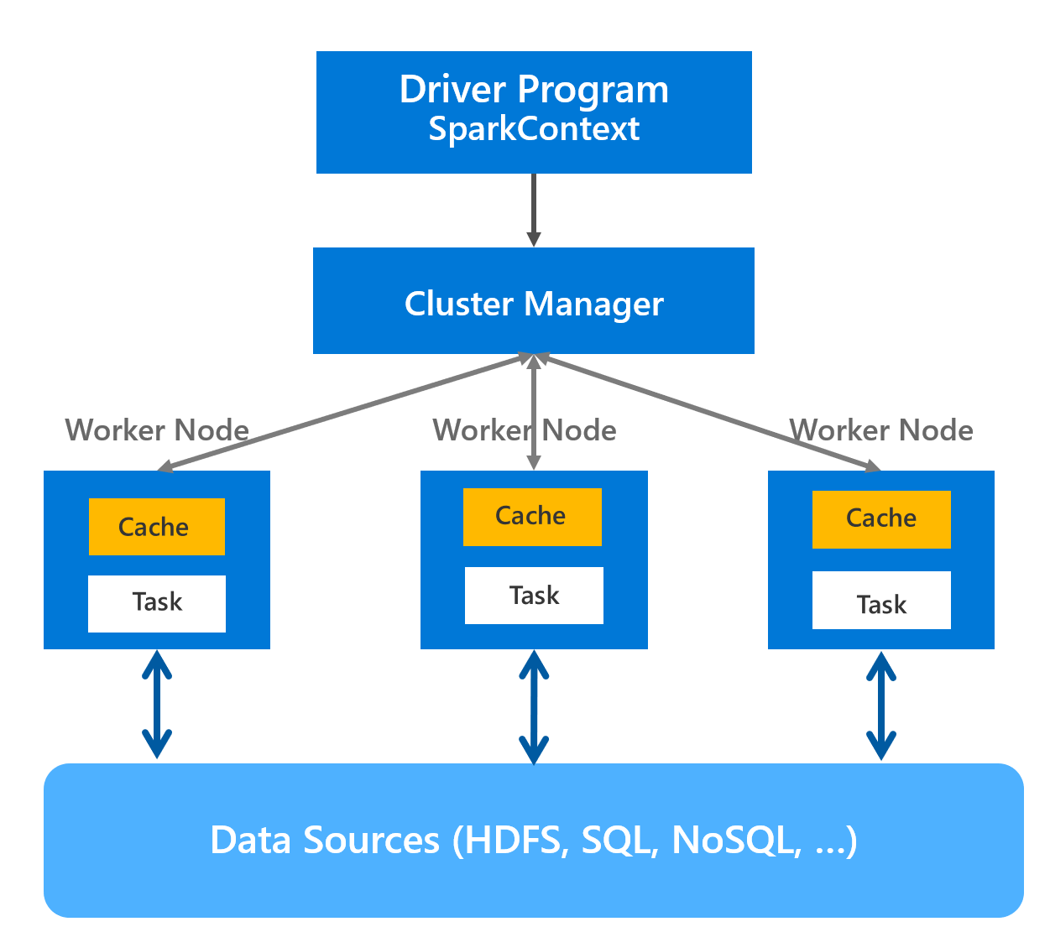
How does it work?
‘Driver’ runs the user’s ‘main’ function and executes the various parallel operations on the worker nodes
The results of the operations are collected by the driver
The worker nodes read and write data from/to Data Sources including HDFS
Worker node also cache transformed data in memory as RDDs (Resilient Data Sets)
Worker nodes and the Driver Node execute as VMs in public clouds (AWS and Azure)
Notes:
Spark is designed to run on a cluster where the workload as spread across all the nodes. Basically, there is one driver (=head-node) and an arbitrary number of executors (=worker-nodes) where the driver controls all the executors. The executors are further separated into different slots where a slot can have a running task or is waiting for a new task.

Slide 13
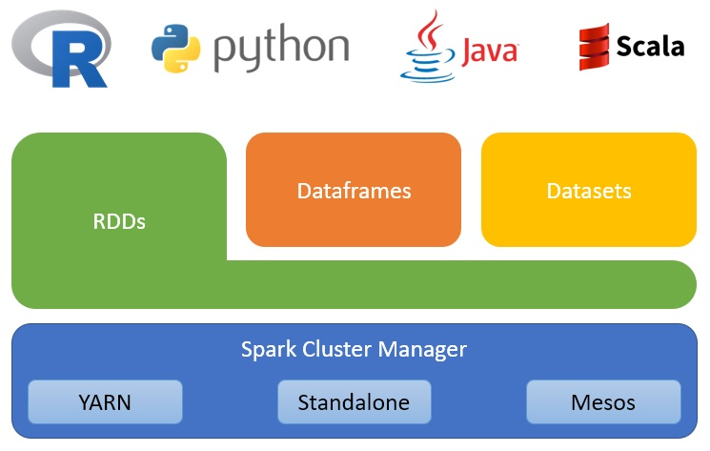
How does it work?
Notes:
The core concept behind Spark are Resilient Distributed Datasets (RDDs). It is an immutable distributed collection of objects. A RDD is divided into logical partitions, which may be processed on different nodes of the cluster. RDDs can contain any type of Python, Java, or Scala objects, including user-defined classes. There are two ways to create RDDs − parallelizing an existing collection in your driver program, or referencing/reading a dataset in/from an external storage system, such as a shared file system, HDFS, HBase, Azure Data Lake store or any other source offering a HDFS interface. Once a RDD is created, the driver can issue command to the drivers which then process the command on the partition of the RDD they have loaded locally. This way whole workload is distributed over the cluster and the driver just acts as a controller without doing any processing itself. When the processing is finished the results can either be written to a storage system by the executors directly (in a prallel) or the RDDs are returned to the driver is a collection for further sequential processing.
Spark Dataframes are an advanced form of RDDs. Compared to RDDs which be a collection of different objects, Dataframes have a defined structure and each item in the collection has to have the same type. In this case this are Row-objects that have a set of columns with a fixed data type. This allows us to process Dataframes much more easily than it would be possible with simple RDDs. However, under the hood, all the processing still happens using basic RDD functions, but this is not transparent to the user.
Given the description above you will see a lot of similarities with regular SQL tables - both are basically a set of rows and columns and can also be processed using very similar commands. The Dataframe API offers native functions for the most common SQL operations like aggregations, goupings, projections, filtering, etc.
First of all, Spark Datasets are only available in Scala. There is no similar API for Python or R. Opposed to Dataframes, Datasets are strongly typed so many errors already pop up at compile time and not only at runtime. For example, when using Dataframes and you refer to a column that does not exist, the compiler will not complain but the later execution will fail. For a Dataset, each column is strongly typed and you can only reference columns that actually exist, otherwise the compiler will throw an error. Eventhough being the most restrictive API, Datasets can also speed up the development significantly.

Slide 14



Azure Databricks
A fast, easy and collaborative Apache® Spark™ based analytics platform optimized for Azure
Best of Databricks
Best of Microsoft
Designed in collaboration with the founders of Apache Spark
One-click set up; streamlined workflows
Interactive workspace that enables collaboration between data scientists, data engineers, and business analysts.
Native integration with Azure services (Power BI, SQL DW, Cosmos DB, Blob Storage)
Enterprise-grade Azure security (Active Directory integration, compliance, enterprise-grade SLAs)
Notes:
Azure Databricks features –
Enhance your teams’ productivity
Get started quickly by launching your new Spark environment with one click.
Share your insights in powerful ways through rich integration with PowerBI.
Improve collaboration amongst your analytics team through a unified workspace.
Innovate faster with native integration with rest of Azure platform.
Build on the most compliant and trusted cloud
Simplify security and identity control with built-in integration with Active Directory.
Regulate access with fine-grained user permissions to Azure Databricks’ notebooks, clusters, jobs and data.
Build with confidence on the trusted cloud backed by unmatched support, compliance and SLAs.
Scale without limits
Operate at massive scale without limits globally.
Accelerate data processing with the fastest Spark engine.

Slide 15

Azure Databricks
Azure Databricks
Collaborative Workspace
IoT / streaming data
Machine learning models
DATA ENGINEER
DATA SCIENTIST
BUSINESS ANALYST
Deploy Production Jobs & Workflows
Cloud storage
BI tools
MULTI-STAGE PIPELINES
JOB SCHEDULER
NOTIFICATION & LOGS
Data warehouses
Optimized Databricks Runtime Engine
Data exports
Hadoop storage
DATABRICKS I/O
APACHE SPARK
SERVERLESS
Rest APIs
Data warehouses
Enhance Productivity
Build on secure & trusted cloud
Scale without limits
Notes:
Databricks, founded by the team that created Apache Spark – unified analytics platform that accelerates innovation by unifying data science, engineering & business.
75% of the code committed to Apache Spark comes from Databricks
Unified Runtime
Create clusters in seconds, dynamically scale them up and down.
They’ve made enhancements to Spark engine to make it 10x faster than open source Spark
Serverless- Auto-configured multi-user cluster, Reliable sharing with fault isolation
Unified Collaboration
Overall – a simple & collaborative environment that enables your entire team to use Spark & interact with your data simultaneously
DE – Improve ETL performance, zero management clusters. Execute production code from within notebooks
DS - For data scientists, easy data exploration in notebooks
Business SME – interactive dashboards empower teams to create dynamic reports
Enterprise Security
Encryption
Fine grained Role-based access control (files, clusters, code, application, dashboard)
Compliance
Rest APIs
DE – DBIO, SPARK, API’s , JOBS
DS – Spark and Serverless, Interactive Data Science
Data Products - Everything
Creators of Spark
Training People
Number of Customers
Ingest
Workflow
Schedule / Run / Monitor
Execute
Troubleshoot
Debug
Production Jobs
---------
Ingest, ETL, Scheduling, Monitoring

Slide 16
Databricks
Azure
Setup (ARM)
Cluster resources (IaaS)
Storage (Blob, ADLS)
User management and Security (AAD)
Orchestration (ADF)

Slide 17
Who is Databricks/Spark for?
Data Scientists
Same Data
Same Language
Same Tools
Data Engineers

Slide 18
Alternatives to Spark & Databricks
Data Lake Analytics
HDInsight / Apache Spark
SQL Server / SQL Data Warehouse
Stream Analytics
HDInsight / Apache Storm, Apache Flink, Apache Beam

Slide 19
What do we want to test?

Slide 20
Test Cases
Interaction between Databricks & Power BI
Why?
Deal with Batch & Streaming on the same platform
Databricks as Backend for Reporting & Analytics with Power BI
Databricks as Unified Analytics Platform
What is out of scope:
Absolute Performance measurements

Slide 21
Test Environment

Slide 22
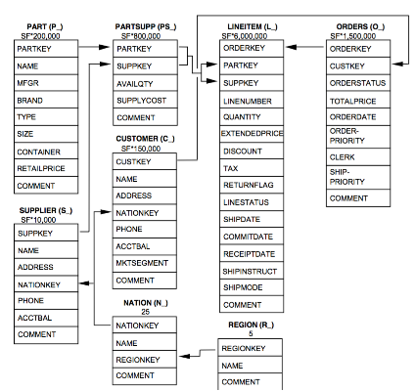
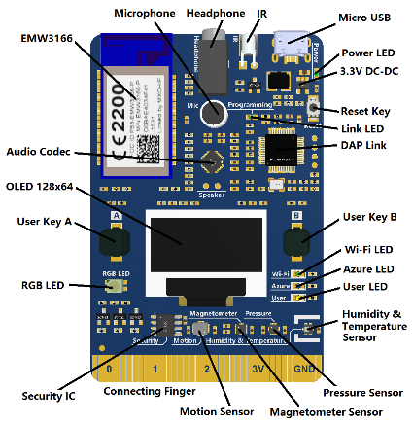
Test data
Batch data
Data waswith TPC-H tool (100 GB Test set)
Data is stored in Blob Storage & Data Lake Gen2
Streaming data
MXChip IoTDevKit
https://microsoft.github.io/azure-iot-developer-kit/
https://s3.amazonaws.com/b2cbucket/tpch_schema.png
https://www.cnx-software.com/wp-content/uploads/2017/06/MXCHIP-Azure-IoT-Devkit.jpg

Slide 23
Test Environment
Azure Databricks
Cluster: Runtime 5.1, 4 Worker Nodes (4 Cores, 14 GB Memory)
Power BI
User Account with free license

Slide 24


Architecture
Ingest
Store
Prepare
Model and serve
IoT Hub
Azure Databricks
Power BI
Azure analysis services
Azure Data Factory
Azure Data Lake

Slide 25
Test cases

Slide 26
Test cases
Load data into Databricks (Batch & Stream)
Design and model tables
Access via Power BI
Import
DirectQuery
Streaming API

Slide 27
Data loading into Databricks

Slide 28
Load of Batch data
Ingest
Store
Prepare
Model and serve
Azure Databricks
Azure Blob Storage
Azure Data Lake

Slide 29
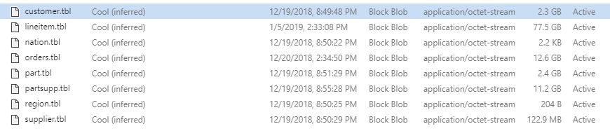
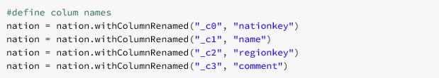
Test 1: Load from Blob Storage
Data size: SF 100, ca. 100 GB

Slide 30
Demo

Slide 31
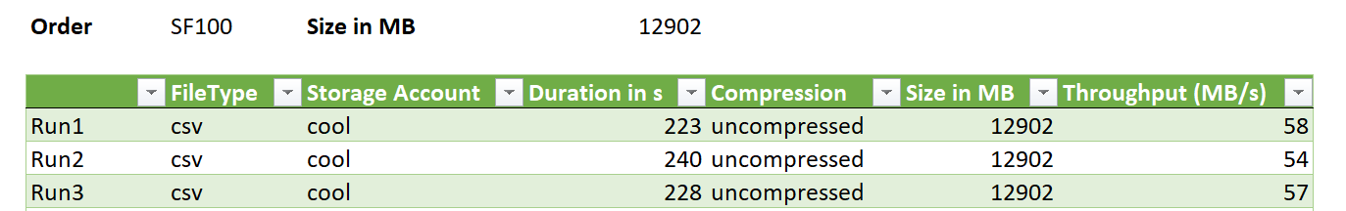
Results
Load of Order data, 13 GB

Slide 32
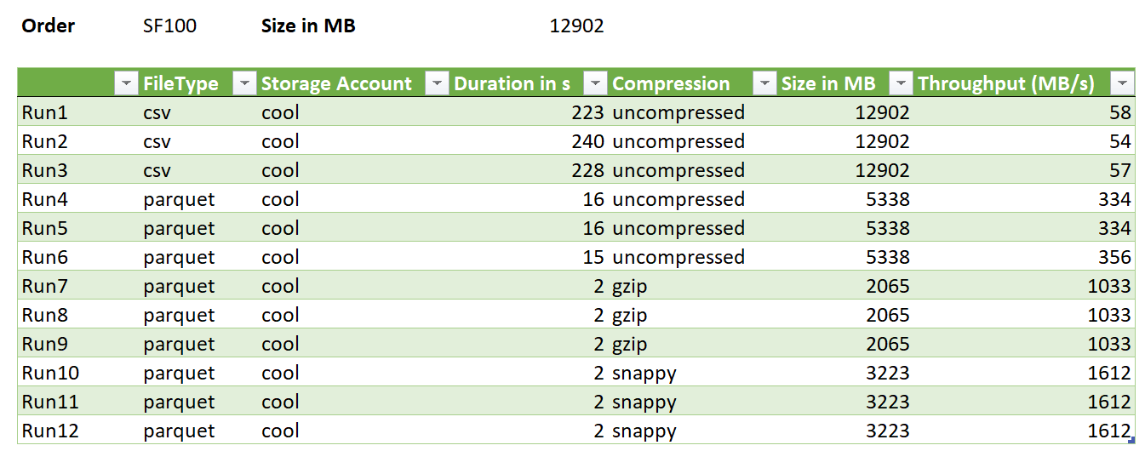
How can I optimize this?
Distribute source data into several files
Data compression

Slide 33
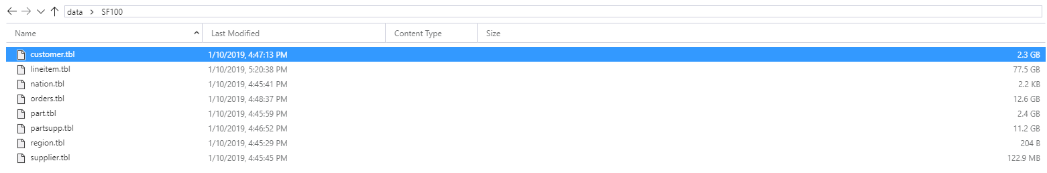
Test 1: Load from Data Lake Gen2
Data size: SF 100, ca. 100 GB

Slide 34
Demo

Slide 35
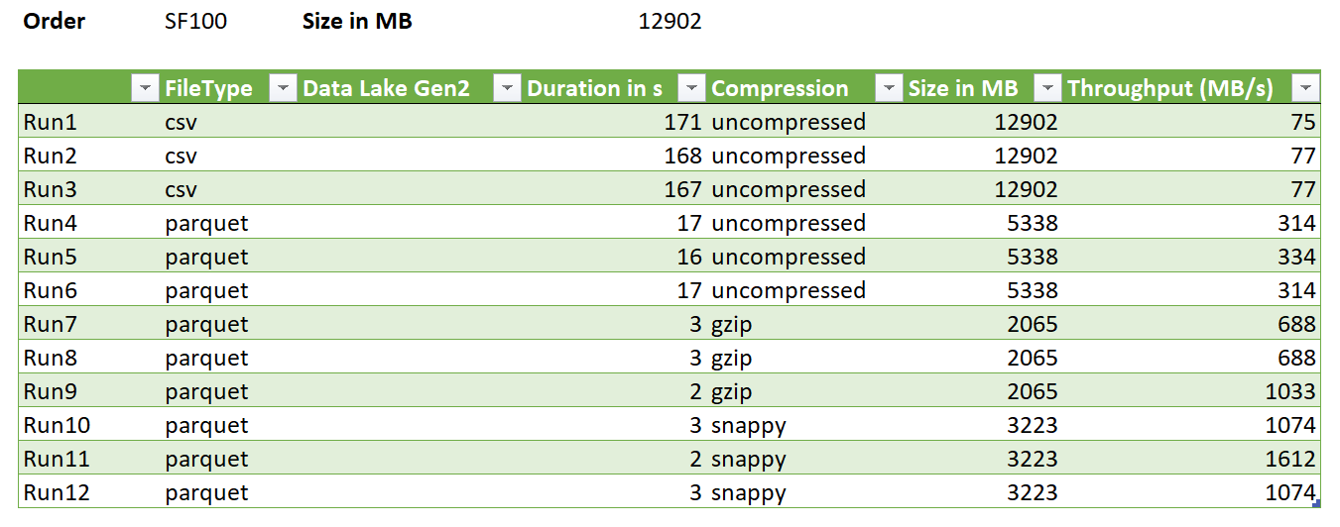
Results

Slide 36
Lessons Learned
Data Lake Gen2 provides best performance for reading and writing
Distribution of data across multiple files improves performance
Databricks Delta not yet supported on Data Lake Gen2

Slide 37
Data Model

Slide 38
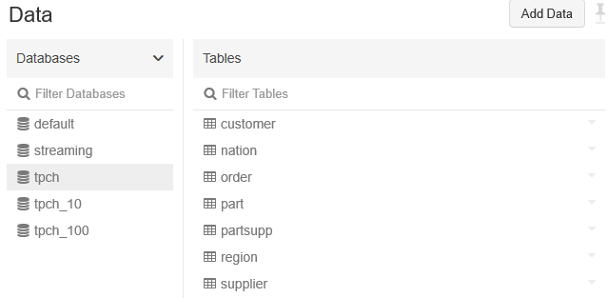
Tables in Databricks
Unmanaged (external) Tables
Managed Tables (Databricks manages data & metadata)
Partitioning is supported
https://docs.databricks.com/user-guide/tables.html#managed-and-unmanaged-tables

Slide 39
Access from Power BI

Slide 40
Ways to connect PowerBI to Databricks
 | Import Mode | Direct Query | Comment
Read from Blob/ADLS | Yes | No | Only specific file formats!
Spark SQL Interface | Yes | Yes
ODBC | Yes | No | Requires gateway!
Polybase Proxy | Yes | Yes | Azure SQL DW, SQL Server + Gateway

Slide 41
Composite Models and Aggregations
Combine Import Mode and Direct Query
Import Aggregations → super fast
Direct Query for Details → keep data model small, use backend

Slide 42
Demo

Slide 43
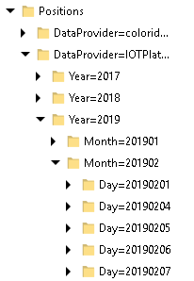
Best Practices and Performance
Use Views in Databricks (or pre-calculate)
No further transformation in Power BI/Power Query
Cache tables (link)
Use proper partitioning and file formats
Use Aggregations as needed

Slide 44
Power BI Premium
For larger amounts of data
Imported data >1 GB
For Partitioning
Should be aligned with Databricks partitions!
For dedicated resources

Slide 45
Working with streaming data

Slide 46
Load of streaming data
Ingest
Store
Prepare
Model and serve
IoT Hub
Azure Databricks
Power BI
Azure analysis services

Slide 47
Connect Databricks with IoT Hub
Connect to the EventHub Endpoint of the IoT Hub
Use a dedicated consumer group per listener
https://docs.azuredatabricks.net/spark/latest/structured-streaming/streaming-event-hubs.html
Data is distributed over partitions per DeviceId!
https://docs.databricks.com/spark/latest/structured-streaming/streaming-event-hubs.html

Slide 48
Demo

Slide 49
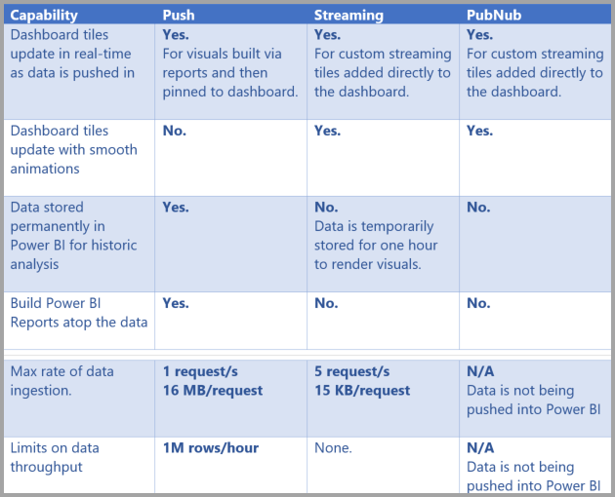
How to analyze the data?
Option 1: Cache data in Databricks, refresh data model in Power BI / Analysis Services
Option 2: Stream data directly into Power BI
Types of Data Sets: Push dataset, Streaming dataset, PubNub streaming dataset
https://docs.microsoft.com/en-us/power-bi/service-real-time-streaming

Slide 50
Demo

Slide 51
Summary

Slide 52
Summary
Data Loading & Processing works very well in Databricks
Choosing the right data format is important
Composite Models and Aggregations help when reporting on “Big Data”
Streaming works in Micro-Batches and is easy to setup
Unified API makes development easy

Slide 53

Feedback

Slide 54
Thank you very much for your attention. Vielen Dank für Eure Aufmerksamkeit.

